Slide 1
Cancellations
A success story ( with something still left to do)

Slide 2
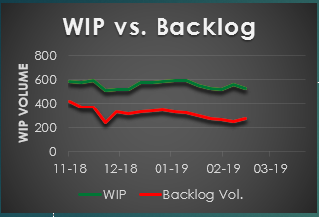
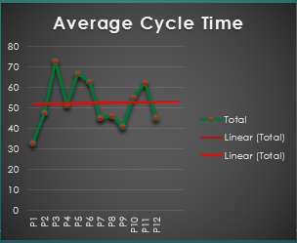
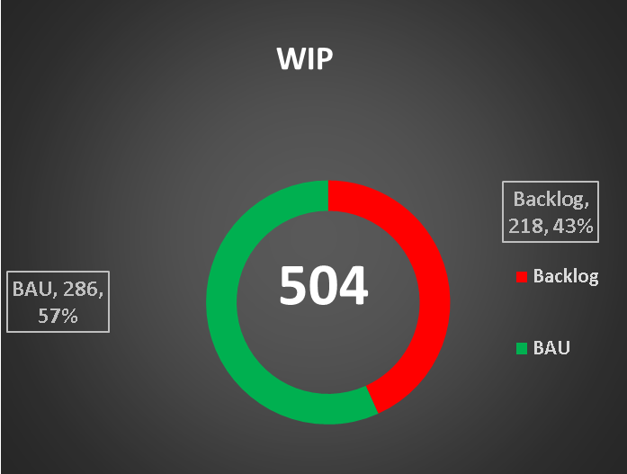
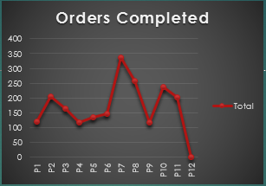
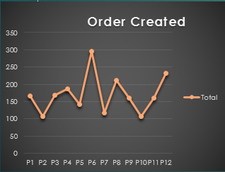
Where we started

Slide 3
Where we wanted to get
Backlog = 3%
Lead Time for Cancellations
Healthy average cycle time
Eliminate waste

Slide 4
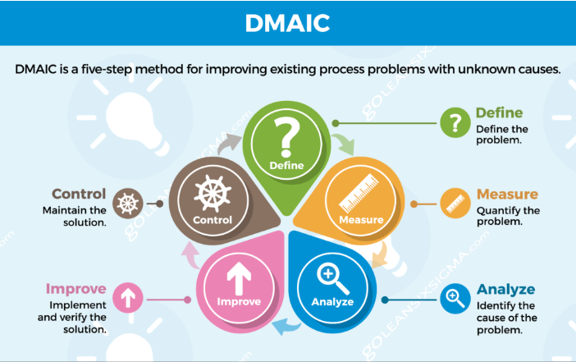
The approach we took Lean Six Sigma Methodology

Slide 5
Define phase Key Steps and Time frame
Due By
RAG
Done
Define & Scope Problem
Identify the business problem
Document the As is Process (Value stream Map)
Identify and translate the VOC
22nd Jan
28th Feb
28th Feb
Determine
Objective & Benefits
Define Metrics
Baseline
Develop Problem Statement and Objectives
Estimate Financial Benefits
28th Feb
28th Feb
22nd Jan
28th Feb
Create Project Charter
Define roles and responsibilities
Identify risks
Establish timeline
Create communication plan
22nd Feb
28th Feb
22nd Feb
01st Feb

Slide 6
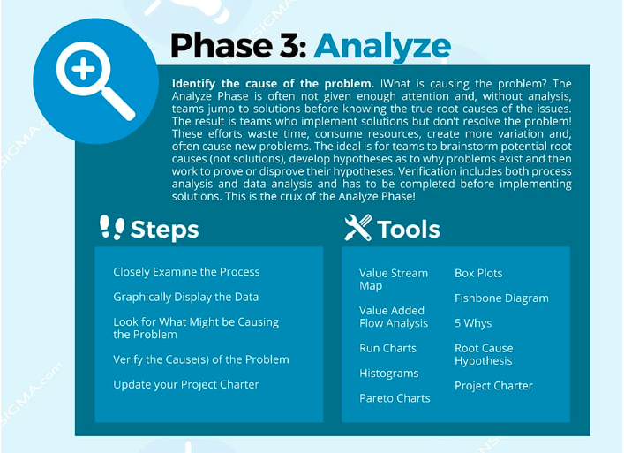
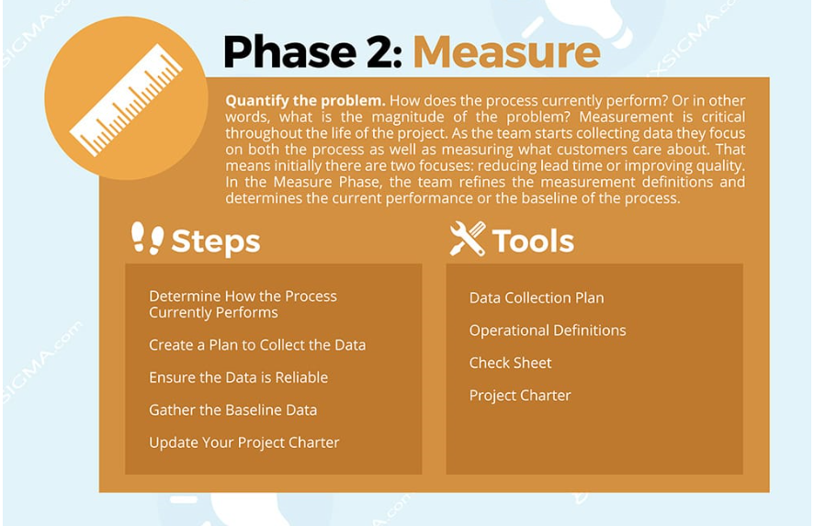

Slide 7
Measure/Analyse Phase Key Steps and Time frame
Due By
RAG
Done
Create plan to collect the data
This connects to the launch of the new dashboard which will be released on the 1st of April 2019
1st April 2019
Baseline current performance
Steps Analysis (BAU and Project)
Orders Analysis (BAU and Project)
Teams demand vs capacity
Bottlenecks
31st of March
31st of March
31st of March
31st of March
Determine improvement initiatives
See slide 26
30th of April

Slide 8
Top 10 Products analysis Project Baseline
Top 10 Products | Orders Vol
BT xDSL / MPLS | 519
BT Business Voice | 481
BT MPLS | 273
BT Etherway | 226
BT Private Line National | 202
BT Etherflow | 81
BT Carrier Services Private Line National | 66
Wan Matrix | 61
BT IP Connect GLOBAL | 30
BT DSL/ IP Connect Ireland -Bitstream | 16
Grand Total | 1955
TOP 10 Products Grouped by Vol | Orders Vol
BT xDSL / MPLS | 519
BT Business Voice | 481
BT MPLS/BT IP Connect GLOBAL | 303
BT Etherway/BT Etherflow | 226
BT Private Line National | 202
BT Etherflow | 81
BT Carrier Services Private Line National | 66
Wan Matrix | 61
BT DSL/ IP Connect Ireland -Bitstream | 16
BT Etherway Access Only | 15
Grand Total | 1970
Products Grouped | Count of Siebel_Order | Average of CT_Ex_Delayed_Days | Average of LateDays
BT Business Voice | 481 | 58 | 226
BT Etherway/BT Etherflow | 226 | 88 | 185
BT Etherway Access Only | 15 | 88 | 55
BT Carrier Services Private Line National | 66 | 62 | 37
BT MPLS/BT IP Connect GLOBAL | 303 | 60 | 22
BT Private Line National | 202 | 33 | 10
Wan Matrix | 61 | 67 | -4
BT DSL/ IP Connect Ireland -Bitstream | 16 | 22 | -15
BT xDSL / MPLS | 519 | 31 | -17
Grand Total | 1970 | 51 | 93

Slide 9
Steps Analysis Bottleneck - ICUKU
Order Progress | Group | Vol | Average of SLA WKDDs | Average of Late DDs
Wait for Cust BillThrough Date | OM | 1 | -143 | 582
Remove Monitoring From ITO | System Engineering | 2 | 3 | 132
Arrange Customer Appointment | Field Logistics | 27 | 3 | 102
 | OM | 94 | 3 | 65
Cancel Usage/DMS Voice Delete | Voice Operations | 421 | 3 | 34
Jumpers/Cards Recovery | Field Logistics | 348 | 4 | 34
Jumpers/Cards Recovery 2 | Field Logistics | 57 | 4 | 26
Cease Completed On Orion | OM | 42 | 29 | 26
 | Service Delivery | 2 | 18 | 19
Jumpers/Cards Recovery 3 | Field Logistics | 2 | 4 | 24
Jumpers/Cards Recovery 4 | Field Logistics | 1 | 4 | 21
Pending OLO Completion | IC Team | 84 | 2 | 14
 | OLO Team | 51 | 2 | 22
Cease In Orion | IC Team | 88 | 3 | 15
Create DCA | Order Operations | 205 | 2 | 14
NTU/CPE Recovery | Field Logistics | 68 | 4 | 13

Slide 10
Improve Phase Key Steps and Time frame
Due By
RAG
Done
Arrange training for Philippines team |  | 1st of May
SU changes on Seibel |  | 21 of March
IT changes on Seibel |  | 31st of April
Complete analysis of GS performance for Orders and Steps |  | 31st of March
Investigate avenue to improve SQE performance/validation |  | 31st of March
Review manual eDCA |  | 31st of March
Launch unified reporting |  | 1st of April
Demand vs Capacity |  | 31st of March
Investigate Domestic Ceases Automation |  | 31st Of March
Tackle Steps bottleneck |  | 30th April
Implement Improvements
Monitor improvements
Trend cycle time for ceases to ensure we did actually eliminated waste
Monitor Ceases Cost
Monitor WIP and Backlog %
Monitor Bottleneck
30th of May
30th of May
30th of May
30th of May

Slide 11
Analysis Improvements Requests/Initiatives
Philippines Training
05
Standard Work EOLAS
01
Creation of Standard work docs to be saved on Eolas and review of current manuals
Training for Cancellation Ticket team on
Siebel and Arbor- ➢
Product guideline: description of each product, how the product works
Contact details for other teams who may help
Billing and notice period
AUTOMATION OF NATIONAL CEASES
02
Manual eDCA
06
Review of manual eDCA time lines to ensure they are in line with Seibel Sunrise
Investigate If it would be possible to fully automate flows where the majority of the steps are updates of db
Flow changes
03
07
UNIFIED reporting
OLO Cease Request step
Update Databases
Infrastructure WP Completed
GIS step
Tick box for multiple resources for J&P
One report for orders and steps with no difference for Ceases and New Provides
04
ADDITION OF COST
08
ICUKU Bottleneck
Addition of Cost figures as per Cost Transformation report in reports and as a tool to prioritise ceases
One report for orders and steps with no difference for Ceases and New Provides
Notes:
© Copyright PresentationGO.com – The free PowerPoint template library

Slide 12
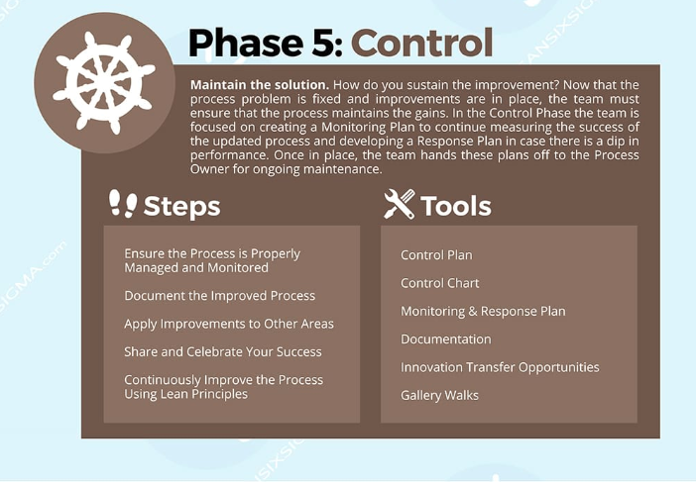

Slide 13
Control Phase Key Steps and Time frame
Due By
RAG
Done
Control Improvements
Organise monthly meeting with team to ensure situation is under control (VN/All) |  | 30th June
Focus on high cost ceases on a monthly basis (VN) |  | Monthly
Issue monthly tracking reporting slide deck to team (VN) |  | 30th June
Ad hoc investigations |  | N/A
Monitor IT to ensure Super User change is implemented (VN) |  | N/A
Initiate Ceases spin off project (CAO/VN) |  | 01st July
Outstanding
Eolas documentation dates
Super User changes for Pending OLO step still presents some difficulties
30th June
30th June

Slide 14
Improvements Measure Orders
Cease Type |  | Before | Current | Movement
Ceases All | Avg Completed per Week | 41 | 75 | ↑
 | Avg Created per Week | 47 | 60 | ↑
 | Avg CT | 53 | 45 | ↑
Ceases Project | Avg Completed per Week | 25 | 25 | →
 | Avg Created per Week | 35 | 10 | ↓
 | Avg CT | 31 | 35 | ↓
Ceases BAU | Avg Completed per Week | 30 | 71 | ↑
 | Avg Created per Week | 23 | 59 | ↑
 | Avg CT | 63

Slide 15
Improvements Pareto Orders
Product | Measure | Before | Current | Movement
BT Business Voice | Avg CT | 58 | 18 | ↑
IP Connect Global | Avg CT | 101 | 59 | ↑
BT MPLS | Avg CT | 56 | 60 | ↓
BT Etherflow | Avg CT | 28 | 23 | ↑
BT Etherway | Avg CT | 107 | 84 | ↑

Slide 16
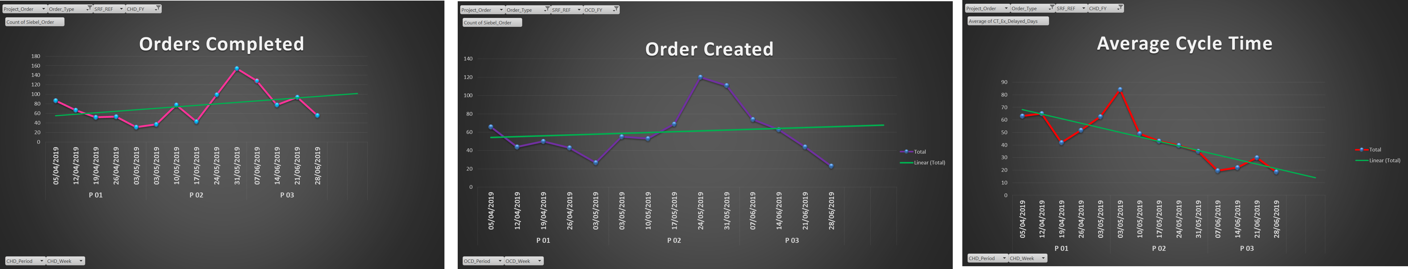
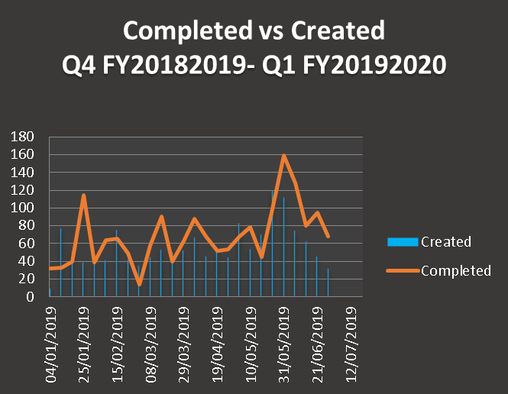
Control Phase Reports Orders All

Slide 17
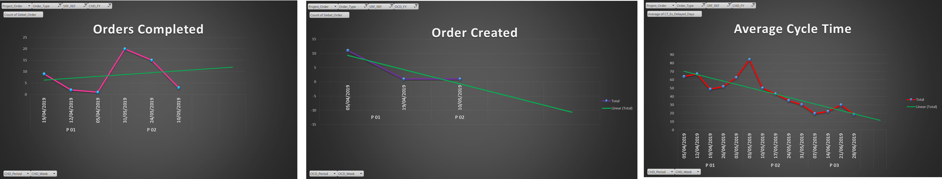
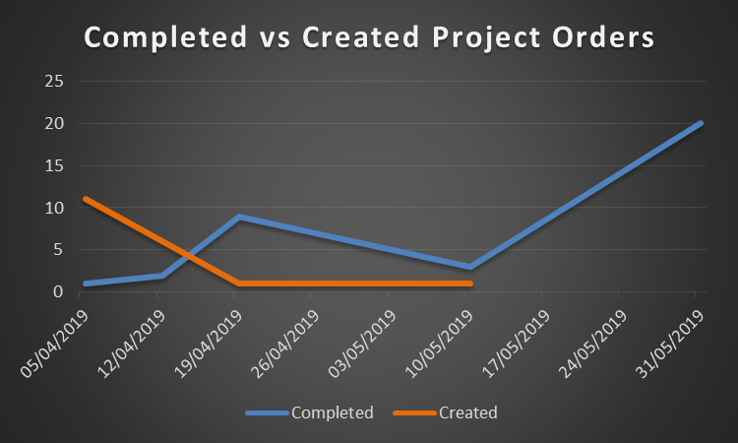
Control Phase Reports Project Orders

Slide 18

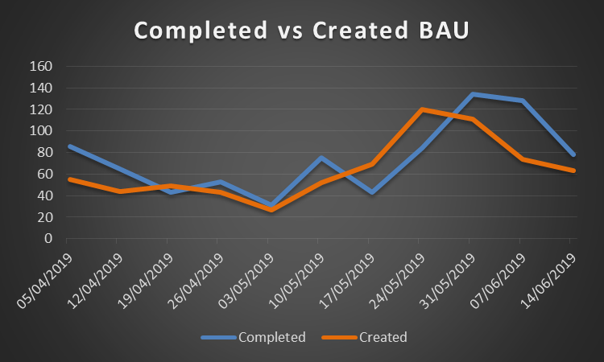
Control Phase Reports BAU Orders

Slide 19
Improvements Bottleneck Steps
Steps | Measure | Before | Current | Movement
Arrange Customer App | Avg late Ds | 102 | 18 | ↑
J&P Recovery | Avg late Ds | 34 | 59 | ↑
Cancel Usage | Avg late Ds | 34 | 60 | ↓
Cease Completed in Orion | Avg late Ds | 26 | 23 | ↑

Slide 20
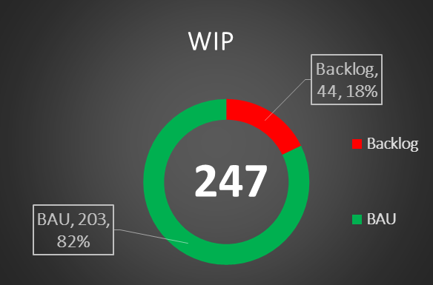
Where we are now
Cancellations Types
Cancellation BT Global 3rd Party
Cancellation BT International 3rd Party
Cancellation BT Domestic BT
Cancellation BT Domestic 3rd Party
Cancellation BT International BT
Cancellation BT Global BT
Cancellation | Lead Time
Cancellation BT Global 3rd Party | 40
Cancellation BT International 3rd Party | 40
Cancellation BT Domestic BT | 15
Cancellation BT Domestic 3rd Party | 15
Cancellation BT International BT | 40
Cancellation BT Global BT | 40

Slide 21
Recommendations
Outstanding actions: documentation of steps in process for Eolas site
Release of change in live environment (1 Super-user and 1 IT)
Review of cancellations tickets process = Making it simple (Valentina Novara/ Carol Ann O’Riordan)
One monthly meeting to ensure things are under control
Monthly monitoring of ceases cost as per Cost Transformation dashboard
Ensure SLA’s performance is kept under tight control for Oms : backlog rising
Team Member | Date | RAG | Comment
Mark Conroy | Completed |  | Completed and Uploaded
Carol A O’Riordan/Thomas Simons | TBC |  | Completed, Eolas admin to review and upload
Cyril Edgely | TBC |  | Completed, Eolas admin to review and upload
Clare Corcoran/Marta Duffy | End Of July
John O’Grady/Martin Atkins | Mid of July

